Slide 1

Department of Computer Engineering
Digital Electronics Laboratory
Name : Dr. Amar Buchade
Teaching Scheme: 2 hrs/week
Examination Scheme:
Term Work : 25 Marks

Slide 2
Departmental Vision & Mission
Department of Computer Engineering
Vision
Achieve academic excellence through education in computing, to create intellectual manpower to explore professional, higher educational and social opportunities.
Mission
To impart learning by educating students with conceptual knowledge and hands on practices using modern tools, FOSS technologies and competency skills there by igniting the young minds for innovative thinking, professional expertise and research.

Slide 3
List of Laboratory Experiments/Assignments
Department of Computer Engineering
Sr. No. | Group A
1 | To Realize Full Adder/ Subtractor using a) Basic Gates and b) Universal Gates
2 | Design and implement Code Converters-Binary to Gray and BCD to Excess-3
3 | Design and Realization of BCD Adder using 4-bit Binary Adder (IC 7483).
4 | Realization of Boolean Expression for suitable combination logic using MUX 74151 /74153, DMUX 74154/74138
5 | To Verify the truth table of two bit comparators using logic gates.
6 | Design & Implement Parity Generator and checker using EX-OR.

Slide 4
List of Laboratory Experiments/Assignments
Department of Computer Engineering
Sr. No. | Group B
7 | Design and Realization: Flip Flop conversion
8 | Design of 2 bit and 3 bit Ripple Counter using MS JK flip-flop. MoD 5 up and Mod 5 down counter
9 | Design of Synchrous 3 bit Up and Down Counter using MSJK Flip Flop / D Flip Flop
10 | Realization of Mod -N counter using ( Decade Counter IC 7490 ) .
11 | Design and implement Sequence generator (for Prime Number/odd and even ) using MS JK flip-flop
12 | Design and implement Sequence detector using MS JK flip-flop

Slide 5
List of Laboratory Experiments/Assignments
Department of Computer Engineering
Sr. No. | Group B
13 | Study of shift registers (SISO, SIPO, PISO, PIPO)
14 | Design of ASM Chart using Mux Controller Method.

Slide 6
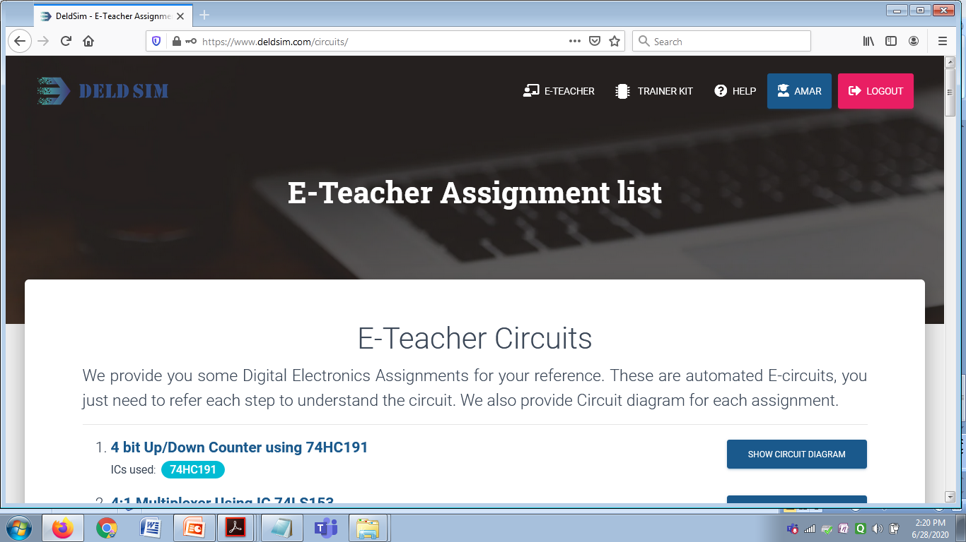
Deld Sim: Digital Electronics Virtual Trainer Kit

Slide 7
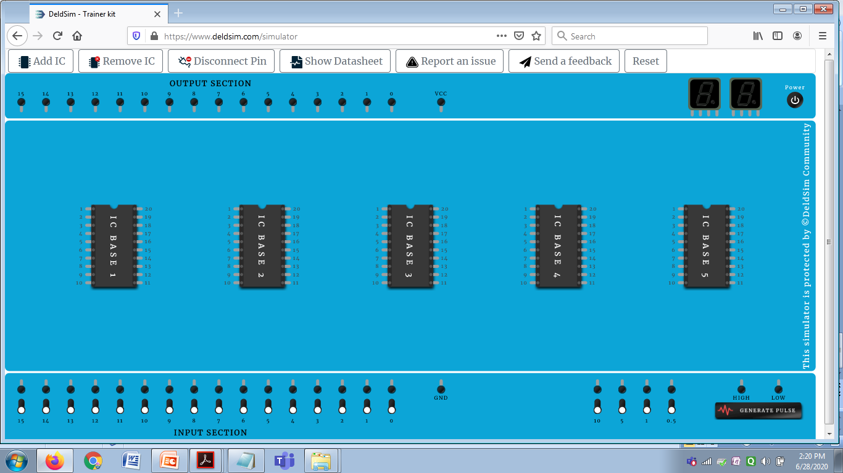
Digital Electronics Virtual Trainer Kit

Slide 8
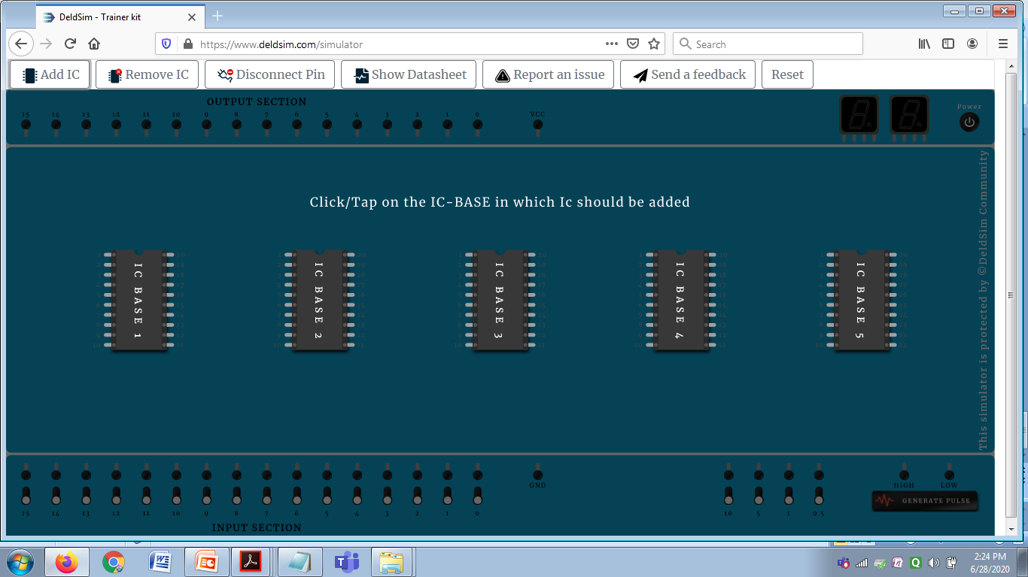
Digital Electronics Virtual Trainer Kit

Slide 9
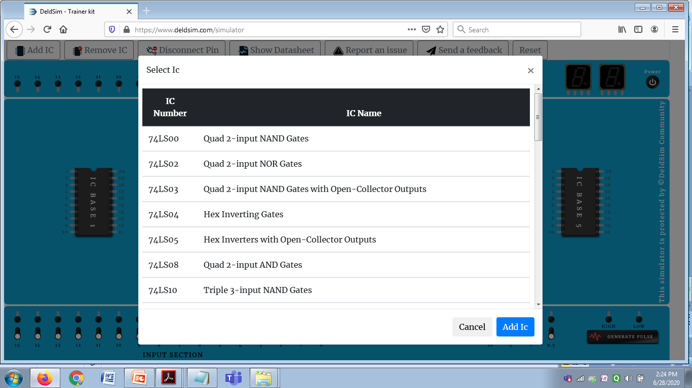
Digital Electronics Virtual Trainer Kit

Slide 10
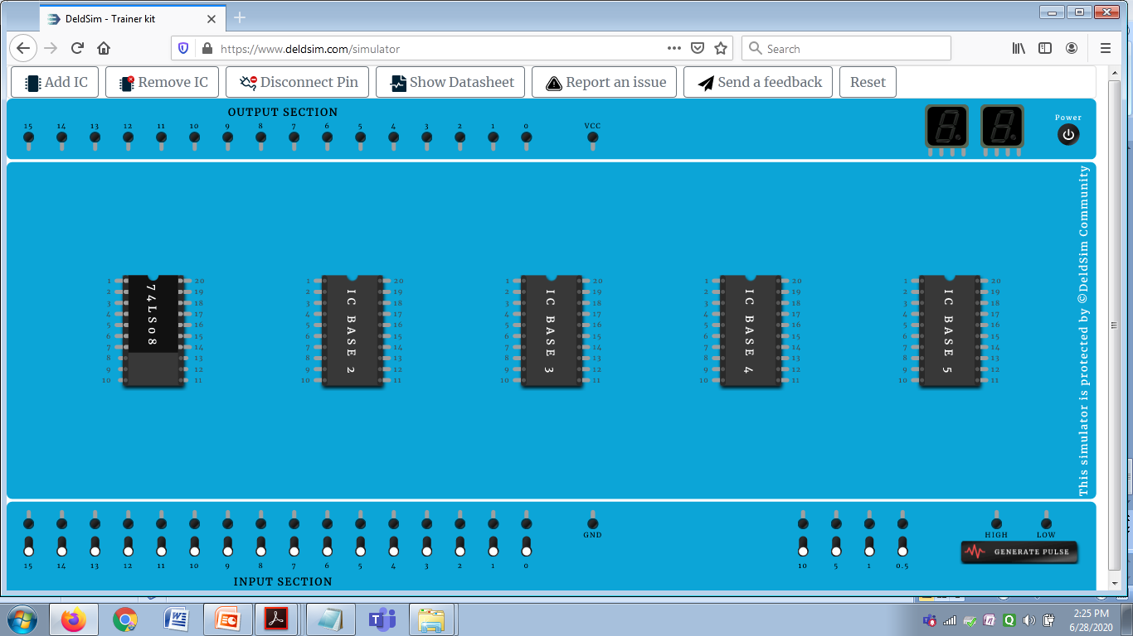
and gate demonstration

Slide 11
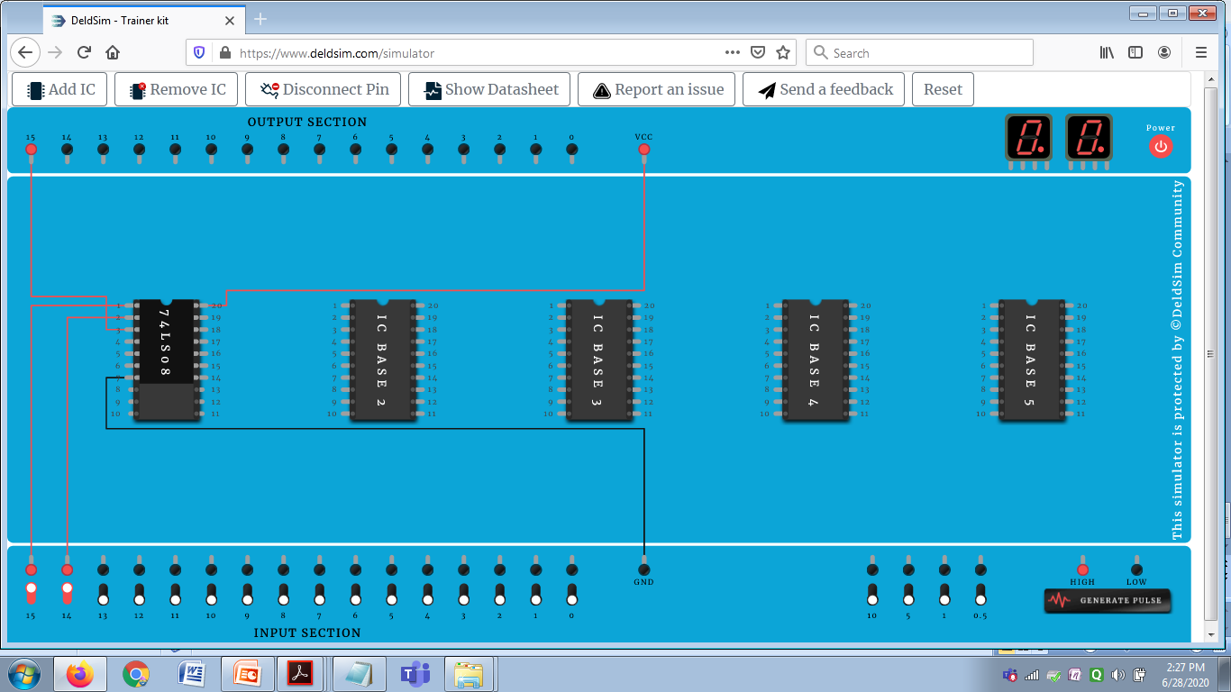
and gate demonstration

Slide 12
Thank you

